Slide 1


Expert Lawyer
A chatbot to answer all your Legal related questions

Slide 2

Market study : problems faced when you need a legal advice
Chatbot solution will be time, money, and effort-saving.
High cost of the legal advice
Clarification
Information Accessibility
Data Integrity
Availability of experts
Time consuming
Notes:
Legal writing is one of the most complicated and ambiguous languages for the common person to understand, getting legal help can be a daunting experience. :
These are the main problems faced when you need a legal advice :
- High cost of the legal advice : getting a legal expert can be so expensive .
Information accessibility : unsure if you can easily access to the legal advice you researched on search engine.
Availability of the experts : Many law expert are not available instantly and you should book a meeting with them in average two weeks.
Clarification : law language is very much complicated than the human brain. That is why law fails to reach to the common people.
Data Integrity : unsure that the legal advice is accurate and updated and from an authorized source.
Time consuming : difficult to find a lawyer with the specific and right expertise to advice you. (Googling for legal advice is time-consuming and you’re never sure if you’re missing something)
-------------------------------------------------------------------------------------------------------------------------------------------
-- Unless you have very close friends or family members who are lawyers, finding legal guidance can be agitating.--

Slide 3
Advantage of Expert Lawyer chatbot
Time is money
Time Saving
billion of hours saved
01
03
User Satisfaction
speed of response and ease of use. The chatbot is faster than a human in terms of quick reponses.
Money saving
02
+10000 M$ of savings

Slide 4





Expert Lawyer: Support multiple platforms
Multi-devices Interface
NLU-NLP Core
(Natural Language Understanding – Natural Language Processing)
Intent analysis
knowledge database
Notes:
Expert Lawyer consists of :
A multidevice interface that allows the bot to be integrated to any type of device (website, messaging, sms)
Natural Language Understanding – Natural Language Processing CORE (NLU –NLP) which allows the understanding of the questions and the formulation of the answers
Intent analysis to research and produce the answers
A knowledge data base which is a source of the law data and information for the bot - the answers are taken from this database.

Slide 5
Solution
A dynamic chatbot that help answer all your law related questions
Expert Lawyer

Slide 6

How it works ?
Data Acquisition api.gov.info : us
Document classification
User intention identification
step 1
step 2
step 3
step 4
step 5
step 6
Topic identification
Explore Entities, Reference, Main Sentences etc ...
Answer generation
Notes:
Our solution Expert Lawyer works on 6 steps :
We acquire data using the api from gov.info
using expert ai we identify each topics and classified them.
we then export entities,reference,main…
we Guide the user through exchanges to refine the need and provide contextual and personalized information.we extract his intent and generate an answer

Slide 7
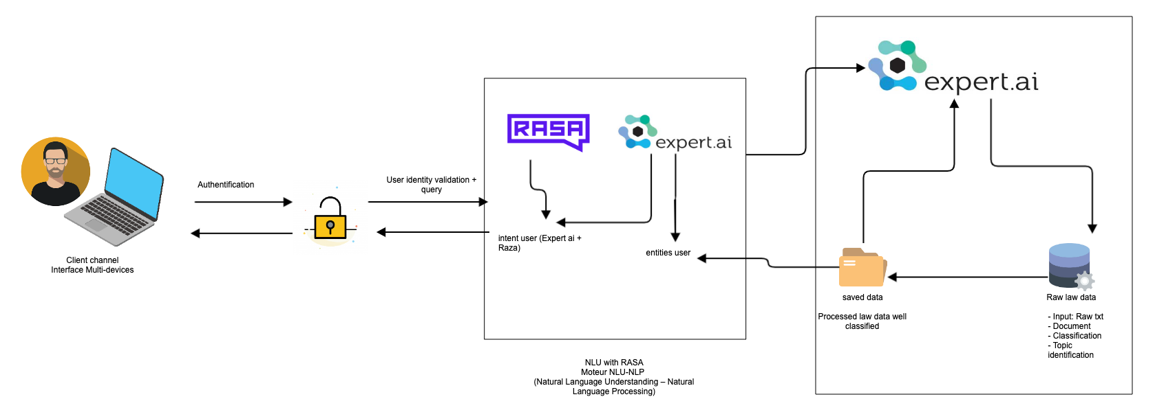
Architecture
Notes:
A user will be able to Authenticate and ask his question using natural language voice or text
the intent is then extracted with expert ai and raza throught a personalized dialogue with the user: with this type of exchange the user's legal needs are better understood before sending the user entity to the backend.

Slide 8






Back-end
Training phase ( Before roll out )
Production phase
Input, question from webchat
Text Analysis
Matching Data
Extract Intent /
Entities by NLU
Classification
Saved processed data:
Candidate responses
Standard context topics()
Document classification()
API call service,
topic modelling
- Lemma -> most important sentence / paragraph
- refre
- Keyphrase extraction
- Named entity recognition
- Full analysis
- Document classification
Response a user
Notes:
The data received will be classified into different topics and documents.
We analyse every document using expert ai in order to extract various information (such lemma,keyphrase...)
and we save the the processed data.
with the user input we will match the entity with and return the best possible answer

Slide 9


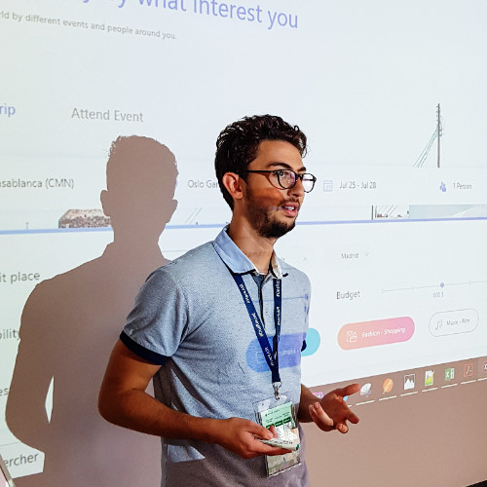

The Team
Med Amine
Idmoussi
Badreddine
LEBBAT
Youness DRISSI
SLIMANI
Hamid LAFERDI
Softwar engineer
Data Scientist
Data Scientist
NLP, Data scientist
Notes:
I want to thank you on behalf of our team

Slide 10
Thank you

Slide 11
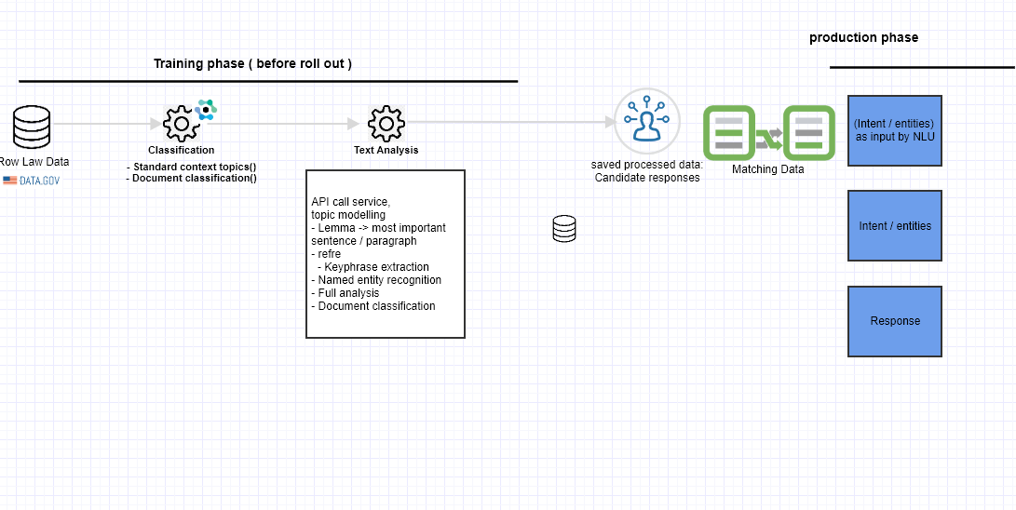

Slide 12









Architecture
Authentification
User identity validation + query
intent user
(Expert ai + rasa )
entities
user
Row Law Data
Saved data
Processed law data well classified
Input: Raw txt 🡪
Document classification
Topic identification
Client channel
Interface Multi-devices
NLU with RASA
Moteur NLU-NLP
(Natural Language Understanding – Natural Language Processing)
Backend Services
Notes:
expert ai extract intention
i want to eat # enti
i have dui = dui

Slide 13
Ideation / brainstorming / innovative Ideas*
Ideation
Innovative solution
Design Thinking / group thinking
sélectionner les problématique
voté pour un problème qui est lie au NLP
Process / technology /User experience / problem solving

Slide 14

key figures
High demand
A high average wait time to get an appointment.
A high demand for lawyers advice
High cost
$100 – $300 Per Hour
the cost does not take in consideration the income of the client.
Statistics
high forum for lawyers
Number of lawyer by citizen (in reducing)
Notes:
There is a high demand for lawyer in the last few years which lead to a high average waiting time for client.
not to mention the high cost a lawyer cost which is the reason people turn to the internet to find answers.

Slide 15
Market study : problems faced when you need a legal advice
Chatbot solution will be time, money, and effort-saving.
Information Accessibility
Many information sources that cannot be all auditable
Clarification
Text laws are often so complicated to understand
High cost of the legal advice
Data Integrity
A meeting with legal expert can be so expensive .
We should verify if the text laws are updated and from an authorized source
Availability of the experts
Time consuming
Many law expert are not available instantly and you should book a meeting with them in average two weeks.
To look for the precise legal case that matches your situation .
Notes:
Legal writing is one of the most complicated and ambiguous languages for the common person to understand, getting legal help can be a daunting experience. :
These are the main problems faced when you need a legal advice :
Information accessibility : unsure if you can easily access to the legal advice you researched on search engine.
Clarification : law language is very much complicated than the human brain. That is why law fails to reach to the common people.
Data Integrity : unsure that the legal advice is accurate and updated and from an authorized source.
-- Unless you have very close friends or family members who are lawyers, finding legal guidance can be agitating.--
Legal writing can be simplified by adopting following changes
• Reducing the use of legal jargon, foreign languages, and archaic words using NLP.
• Break up lengthy sentences into shorter ones with simpler language.
• Analyse the content and only include what is absolutely necessary for the document’s particular use.

